Slide 1
Power BI
Performance Best Practices

Slide 2

– Introductions
– Power BI Report Development Overview
POWER BI REPORT DEVELOPMENT BEST PRACTICES
– Analyse data and build your data model
Requirements gathering
Connect to data
Transform your data
Build your data model
DAX measures
– Report Design
– Prepare to share your report
– Share your report
Set up data gateway
Schedule refresh
– Governance
– Tools to check report performance
– Discussion and Feedback
Agenda

Slide 3
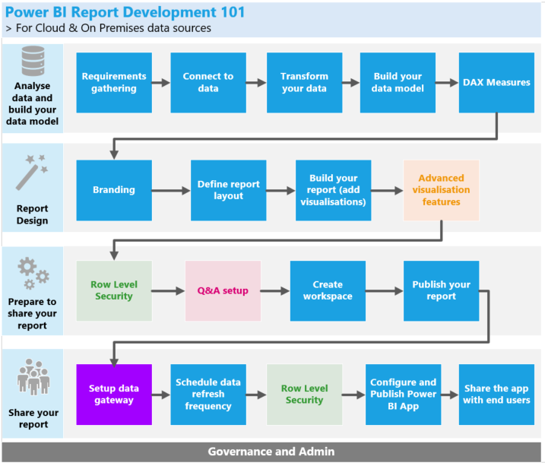
Notes:
Performance comes in many shapes. It doesn’t have to be just about a report being slow, it can also be about the report not being used as it should, not showing the correct data etc.

Slide 4

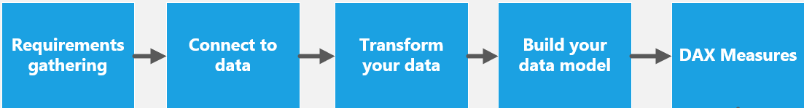
Requirements gathering
Know your audience
Understand the data
Define success criteria
Understand the problem/request
Before you start your report development you should…
Understand the problem/request:
This first step is often overlooked. Building a report without having a good understanding of the business problem you’re trying to solve is like driving a car with no GPS. If you don’t know where you’re going, the chances are you will probably end up in a completely different place from the one you’re supposed to be.
Know your audience:
With Power BI, it’s really easy to build a report in a very short time, but if you don’t know your audience and what their expectations are, it will be really hard for you to come up with a solution that will fulfil their needs. A report built for C level users will be different from a report built for analysts for example. Executive reports tend to be a lot more high level.
Know your data:
Understanding the data you will use in your report is fundamental for any successful project. Ask yourself questions like: What data do I need/have? What will the data model look like? Do I understand the tables, metrics? Is the data cleaned and in a good shape for the report I want to build?
Define success criteria:
What does success look like for your business stakeholders and end users?
Defining the success criteria for your reporting project will allow you to align all the previous steps.

Slide 5


Connect to data
Deciding the connectivity mode you will use for your data sources is one of the first steps when building your Power BI data model. You should invest time on a solution that will optimize your data model performance.
Which connectivity mode should I use?
Import
Your dataset is less than 1GB (compressed)
Your data only needs to be refreshed a few times a day
Direct Query
You have a large dataset (>1GB)
Your data is stored in one a source that supports Direct Query (check here)
Live Connection
Analysis Services is already in use
You have Analysis Services 2016+ Tabular instances (you might have performance issues with older AS instances and Multidimensional instances)
Analysis Services instance is on the cloud (on prem can cause latency issues)
You are not planning to do transformations over the data or complex measures
You’re not planning to use Q&A
Your data model is complex (lots of data transformations, complex measures)
You want the best possible performance
You want your data to be updated in near real time
You are not planning to do data transformations (combining tables etc)
You are not planning to build measures with complex logic

Slide 6
Connect to data
Import – What to do when your data model is too large (>1GB)
There will be times where your data model will become quite large. Here are a few options that can help you improve your performance:
Consider using dataflows + shared datasets (link)
Consider using composite models (link)
Use parameters to filter large tables and reduce the amount of data loaded (link)
Consider using incremental refresh (link)
For very large datasets, consider creating a subset of the model for the most common reporting scenarios – composite models (link)
Often, stakeholders/users will ask to have the maximum amount of data possible, and for it to be refreshed in near real time.
You should analyse this type of request carefully, as most of the times the reality is that this is not needed. If the source data is only refreshed every week, refreshing your Power BI report every day won’t bring any value to your solution or your end users.
Notes:
Explain what is:
dataflows + shared datasets
composite models
parameters to filter large tables and reduce the amount of data loaded – example on how to set up a query parameter
incremental refresh- show how you can enable incremental refresh on Power BI Service

Slide 7
Connect to data
How can I improve performance when connecting to data?
Import only necessary fields and tables
Centralised vs departmental/personal data sources: you should avoid using departmental/personal data sources when possible
Minimize the use of Excel, csv and text files when practical
Use relational database sources when practical
Prefer connectivity on data sources which support native queries and filters (e.g. SQL Server)
Delegate as much processing to the data source as possible
Disable background data refresh (link)
If safe, disable privacy settings or set both sources to Organisational (link)
Test data refresh in the Power BI service regularly during development

Slide 8
Transform your data - Import
How can I improve performance when transforming data?
Leverage query folding
Place filters steps before row-holding steps - operations pushed down to source are often much faster
Filter out unnecessary columns and rows
Always start with the minimum data you need to build your report. This includes removing redundant columns in related tables, and removing columns that contain values calculated from other columns
Reduce usage of long-length columns with high precision and cardinality
Examples are columns with decimal places, long text, Date/Time… the more unique values a column contains, the less efficient the compression will be. Consider reduce the number of decimal places, split date and time in two separate columns
Turn off Auto Date Time (link)
This creates many internal date tables that can be significant in smaller models
Avoid transformations that scan whole tables
If not folded, the entire table needs to be loaded to memory before moving to next step – consider using DAX measures instead
Avoid joining large tables in query editor
Entire table needs to be loaded to memory to perform a join
Don’t load intermediate queries
When using tables that are only used as intermediate queries, disable the data load
Group by and summarize
Perhaps the most effective technique to reduce a model size is to load pre-summarized data.
Notes:
Show an example of a query with non of the best practices applied and a query with all the best practices applied
Show how to see if query is folding and how to reduce auto date time

Slide 9
Transform your data – Direct Query
How can I improve performance when transforming data?
If your using Direct Query mode, you should follow the best practices mentioned in the previous slide, but also the ones below, that apply specifically to queries connected to the source using Direct Query:
Avoid complex Power Query queries
An efficient model design can be achieved by removing the need for the Power Query queries to apply any transformations. It means that each query maps to a single relational database source table or view.
Examine the use of calculated columns and data type changes
Direct Query models support adding calculations and Power Query steps to convert data types. However, better performance is often achieved by materializing transformation results in the relational database source, when possible.
Do not use Power Query relative date filtering
This type of filter translates to an inefficient native query
Limit parallel queries
You can set the maximum number of connections Direct Query opens for each underlying data source. It controls the number of queries concurrently sent to the data source

Slide 10
Build your data model - Import
How can I improve performance when modelling data?
Relationship tuning:
Ensure tables have relationships
Validate and Use Inactive Relationships Purposefully
Avoid bi-directional relationships against high-cardinality columns
Avoid excessive bi-directional or many-to-many relationships
Many-to-many relationships should be single direction
Aim for star schemas, avoid snowflake schemas
Modelling tuning:
Hide all fields not used directly by users
Model should have a date table
Reduce number of calculated columns
Reduce usage of calculated tables
Optimize column data types and precision
Turn off column hierarchies
Notes:
Show relationship properties

Slide 11
Build your data model – Direct Query
How can I improve performance when modelling data?
The considerations we’ve enumerated before for Import mode also apply to Direct Query mode. Once more, these are just a few extra considerations you should take into consideration when using Direct Query.
Avoid relationships on calculated columns
The calculation expression will be embedded into the source queries. Not only is it inefficient, it commonly prevents the use of indexes
Set relationships to enforce integrity
The Assume Referential Integrity property of Direct Query relationships determines whether Power BI will generate source queries using an inner join rather than an outer join
Examine the use of calculated columns and data type changes
Better performance is often achieved by materializing transformation results in the relational database source, when possible

Slide 12


DAX Measures
How can I improve performance when building DAX measures?
Performance tuning:
Use DAX variables if possible
Try to avoid DAX iterator functions (e.g. sumx)
Consider using the divide() function
Use calculated measures rather than calculated columns when possible
Usability tuning:
Store all your measures in a separate table
Name your measures in a meaningful way - avoid ambiguity in names of columns and measures
Format all currency & decimal measures to defined standard (perhaps 2 decimal, thousand separator)
Use Explicit Measures, not Implicit Measures. Simply put, implicit measures are measures that are automatically assigned an aggregation such as a Sum or a Count by Power BI
Consider using DAX Studio to check your model performance
Consider using Tabular Editor Best Practices to improve model design and performance
This tool would notify you of potential modelling missteps or changes which can be made to improve the model design and performance. This includes recommendations for naming, user experience and common optimizations that can be made to improve performance.

Slide 13

Report Design
How can I improve performance when designing my report?
Design tuning:
Use templates (.PBIT files) to speed up and standardize report development instead of starting with an empty .PBIX
Have a hyper-focus on usability of the report for end users
Address accessibility early in the design phase
Carefully review the data displayed to assess if it can be easily misinterpreted
How to present information:
Use careful placement and a clear hierarchy for displaying information on the page
Have a specific purpose for each page, and for each chart on each page
Be consistent with placement of items which appear on multiple pages
Use a layout that focuses on telling the story you want to tell
Avoid clutter on the page to allow report consumers to focus on what is important
Use the right visualisation for the data (Pie charts, donut charts, gauges, and other circular chart types aren't a data visualization best practice)
Use a colour palette that follows visualization best practices and the company branding guidelines
Use very clear titles, labels, and descriptions
Use bookmarks to create 'help' information to guide users
Performance Analyser
Consider using Power BI Performance Analyser
Monitor your report and see details about the time taken by each visual to query for its data and render the result.
Notes:
Use templates (.PBIT files) to speed up and standardize report development instead of starting with an empty .PBIX
Use careful placement and a clear hierarchy for displaying information on the page
Have a specific purpose for each page, and for each chart on each page
Be consistent with placement of items which appear on multiple pages
Use a layout that focuses on telling the story you want to tell
Avoid clutter on the page to allow report consumers to focus on what is important
Use the right visualisation for the data (Pie charts, donut charts, gauges, and other circular chart types aren't a data visualization best practice)
Use colour sparingly, and consistently, with a specific intention in mind
Use a colour palette that follows visualization best practices. If you are required to follow a vibrant organizational colour palette, investigate if you can mute the colours
Address accessibility early in the design phase
Have a hyper-focus on usability of the report for end users
Carefully review the data displayed to assess if it can be easily misinterpreted
Using very clear titles, labels, and descriptions can be extremely helpful to aid comprehension by all report consumers
Use bookmarks to create 'help' information to guide users
Solicit feedback from consumers for both effective data presentation and data

Slide 14
Report Design
How can I improve performance when designing my report?
Performance tuning:
Avoid dense report pages - limit the number of visuals in reports
Avoid “data dump”-style reports with tables containing hundreds of columns and thousands of rows
Consider using slicers and filters in your reports to allow the user to select just the data that is needed to be displayed at any one time
Consider adding an “Apply filters” button to your report
Consider using techniques such as bookmarks and drill through pages
Be intentional with selections for each visual
Only use custom visuals (AppSource) from sources that you trust – preferably certified
Change the interactions between visuals
Enable Row Level Security (RLS)
Performance Analyser
Consider using Power BI Performance Analyser
Monitor your report and see details about the time taken by each visual to query for its data and render the result.
Notes:
Avoid “data dump”-style reports with tables containing hundreds of columns and thousands of rows
This is usually created when the user expects to export this data to Excel. (If the user intends to export data to Excel, consider designing the report directly within Excel to provide the data required but with a live connection to the dataset)
Consider using slicers and filters in your reports to allow the user to select just the data that is needed to be displayed at any one time
Set the slicer or filter at report publishing time, so the initial rendering of the report performs acceptably
Consider adding an “Apply filters” button to your report
With this, your visuals won’t update automatically every time you change a filter/slicer in a page
Be intentional with selections for each visual
Focus on its ability to convey information, resisting the urge to use a variety of visual types for aesthetic appeal only
Enable Row Level Security
With RLS, Power BI only imports data the user is authorized to view

Slide 15
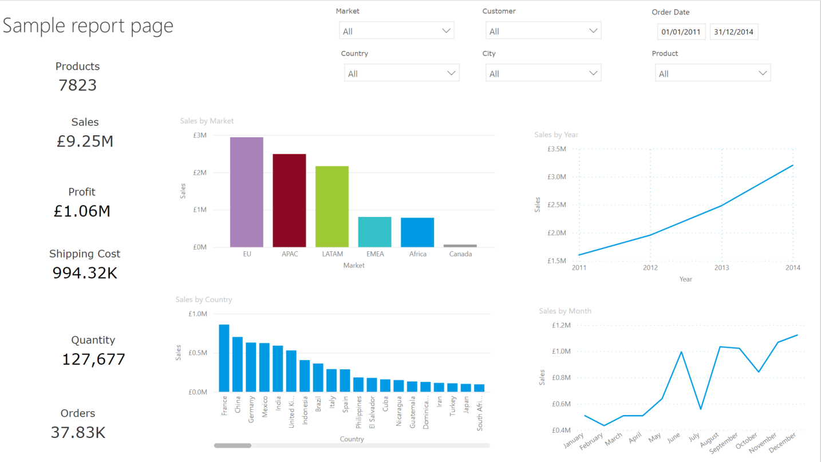

Report Design
How can I improve performance when designing my report?

Slide 16
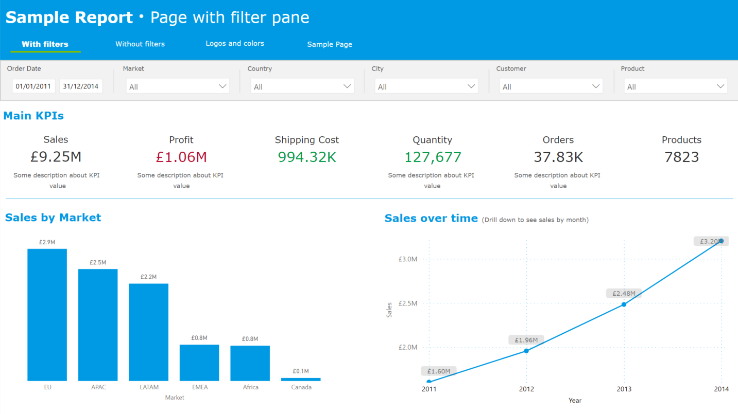
Report Design
How can I improve performance when designing my report?

Slide 17

Prepare to share your report
How can I improve performance when using Row Level Security?
RLS works by automatically applying filters to every DAX query, and these filters may have a negative impact on query performance. So, efficient RLS comes down to good model design (Refer to Analyse data and build your data model section).
In general, it's often more efficient to enforce RLS filters on dimension-type tables, and not fact-type tables
Rely on well-designed relationships to ensure RLS filters propagate to other model tables
Avoid using the LOOKUPVALUE DAX function when model relationships could achieve the same result
Avoid complex RLS rules
Whenever RLS filters are enforced on Direct Query tables and there are relationships to other Direct Query tables, be sure to optimize the source database
How can I improve performance when using Q&A?
The performance of the queries done through Q&A will depend directly on all the work you’ve done previously on trying to improve your data model performance.
Notes:
Talk about pro vs premium workspaces (1gb limitation, refresh limitation, user licensing etc)
There are a lot of best practices regarding Q&A (naming conventions, synonyms etc) that we are not going to discuss here today.

Slide 18

Share your report
Setup data gateway:
Use Enterprise data gateway instead of Personal Gateway
Use different Power BI gateways for "Scheduled Refresh" and "Direct Query"
Schedule your data refresh:
If possible, enable incremental refresh
Analyse carefully the frequency of your data refresh
Think about the refresh time for your dataset
Other considerations:
Add users to Office or Azure Active Directory groups and then use groups to share report content.
Consider promote/certify your dataset so that it can be reused by others in the organisation
Ensure the Power BI report and data source are in the same region
Some questions you should think about…
How often will report consumers view the data?
How quickly are report consumers be expected to act on the data?
Does refreshed data have to be available first thing in the morning?
Are there end-of-day processes that would make a data refresh at the close of business helpful?
Are there international users with different timing needs?
Notes:
Schedule your data refresh:
If possible, enable incremental refresh
Analyse carefully the frequency of your data refresh. The users may want a dataset refreshed 48x a day, but if your data source only refreshes 1x a day, having a refresh frequency higher than that won’t bring any value to your solution o
Think about the refresh schedule for your dataset – you might want to schedule your refresh at a “quieter” time to ensure you don’t have a lot of concurrent refreshes with other reports
Other considerations:
Add users to Office or Azure Active Directory groups and then use groups to share report content. If you are using role-based or row-level security, use groups to manage role membership
Consider promote/certify your dataset so that it can be reused by others in the organisation – this can potentially avoid a lot of dataset duplication
Ensure the Power BI report and data source are in the same region: With the tenant and data source in the same region, you can reduce network latency. The results are faster data transfer and faster query execution.

Slide 19
What tools can I use to check my report performance?
Performance analyzer
DAX studio
Vertipaq
Tabular Editor

Slide 21

Analyse data and build your data model
Global Considerations
Requirements gathering:
Before start building a report, spend time understanding the business problem your trying to solve, your audience, your data and the success criteria.
Connect to data:
Carefully analyse which storage mode you should be using – Import, Direct Query or Live Connection.
Import – best if your dataset is not too large (<1GB* after compression) and direct query/live connection is not available for the connector you’re using. Best if you don’t need live data, your refresh can be scheduled to run at specific times of the day. It has the best performance and no restrictions on data modelling transformations and measures.
Direct query: best if your dataset is very large and you need your data to be updated in near real time. Best if you don’t need to do a lot of data transformations and measures on top of your source data.
Live connection: best if you’re using a shared Power BI dataset, or if you are already using Analysis Services.
Other relevant best practices:
Centralised vs departmental/personal data sources: you should avoid using departmental/personal data sources when possible (Minimize the use of Excel, csv and text files when practical)
Delegate as much processing to the data source as possible
Use relational database sources when possible
Consider using Vertipaq Analyzer to check your queries performance

Slide 22
Analyse data and build your data model
Global Considerations
Transform your data:
Filter unnecessary columns and rows (including removing redundant columns in related tables)
Avoid high granularity data: Group by and summarize your data – in case you need high granularity, consider using composite models
Avoid the usage of long length columns with high precision and cardinality such as long text, decimal places, date/time (split date/time into two different columns)
Avoid transformations that scan whole tables like joins (consider using DAX measures/relationships instead)
Don’t load intermediate queries – disable the data load
Group by and summarize your data
Build your data model:
Avoid bi-directional or many-to-many relationships (if not possible, many to many should be single direction)
Avoid bi-directional relationships against high-cardinality columns
Aim for start schemas, avoid snow flake schemas
Reduce the number of calculated columns
Reduce the usage of calculated tables
Optimize column data types and precision
Turn off column hierarchies
Consider using Vertipaq Analyzer to check your queries performance

Slide 23
Analyse data and build your data model
Global Considerations
DAX Measures:
Avoid complex calculation logic
Use DAX variables if possible
Try to avoid DAX iterator functions (e.g. sumx, average, rankx…)
Use calculated measures rather than calculated columns when possible
Consider using DAX Studio to check your model performance
Consider using Tabular Editor Best Practices to improve model design and performance
Think of how ‘Spell Checker’ works in Microsoft Word. It notifies you of spelling or grammar mistakes while you are typing. This tool would notify you of potential modelling missteps or changes which can be made to improve the model design and performance. This includes recommendations for naming, user experience and common optimizations that can be made to improve performance.

Slide 24
Report Design
Global Considerations
Performance tunning:
Avoid dense report pages - aim to minimize both the amount of data displayed as well as the number of visuals displayed on a page
Avoid “data dump”-style reports with tables containing hundreds of columns and thousands of rows, usually created when the user expects to export this data to Excel. If the user intends to export data to Excel, consider designing the report directly within Excel to provide the data required but with a live connection to the dataset
Consider using slicers and filters in your reports to allow the user to select just the data that is needed to be displayed at any one time. We also recommend setting the slicer or filter at report publishing time, so the initial rendering of the report performs acceptably
Consider adding an “Apply filters” button to your report, so that your visuals render automatically every time you change a filter in a page
Consider using techniques such as bookmarks and drill through pages to reduce the amount of data displayed on a page
Be intentional with selections for each visual. Focus on its ability to convey information, resisting the urge to use a variety of visual types for aesthetic appeal only
Only use custom visuals from sources that you trust – preferably certified
Change the interactions between visuals – visuals filtering other visuals unnecessarily can make your report run slow
Performance Analyser
Consider using Power BI Performance Analyser

Slide 25
Prepare to share your report
Global considerations
RLS works by automatically applying filters to every DAX query, and these filters may have a negative impact on query performance. So, efficient RLS comes down to good model design (Refer to Analyse data and build your data model section).
In general, it's often more efficient to enforce RLS filters on dimension-type tables, and not fact-type tables
Rely on well-designed relationships to ensure RLS filters propagate to other model tables
Avoid using the LOOKUPVALUE DAX function when model relationships could achieve the same result
Avoid complex RLS rules
Whenever RLS filters are enforced on DirectQuery tables and there are relationships to other DirectQuery tables, be sure to optimize the source database

Slide 26
Share your report
Global considerations
Setup Data Gateway:
If you have on premises data sources, consider using one gateway for Imported datasets and another one for Direct Query datasets (do not use personal data gateway)
Schedule data refresh:
If possible, enable incremental refresh
Analyse carefully the frequency of your data refresh. The users may want a dataset refreshed 48x a day, but if your data source only refreshes 1x a day, having a refresh frequency higher than that won’t bring any value to your solution o
Think about the refresh schedule for your dataset – you might want to schedule your refresh at a “quieter” time to ensure you don’t have a lot of concurrent refreshes with other reports
Other relevant best practices:
Consider promote/certify your dataset so that it can be reused by others in your organisation – this can potentially avoid a lot of dataset duplication

